Slide 1
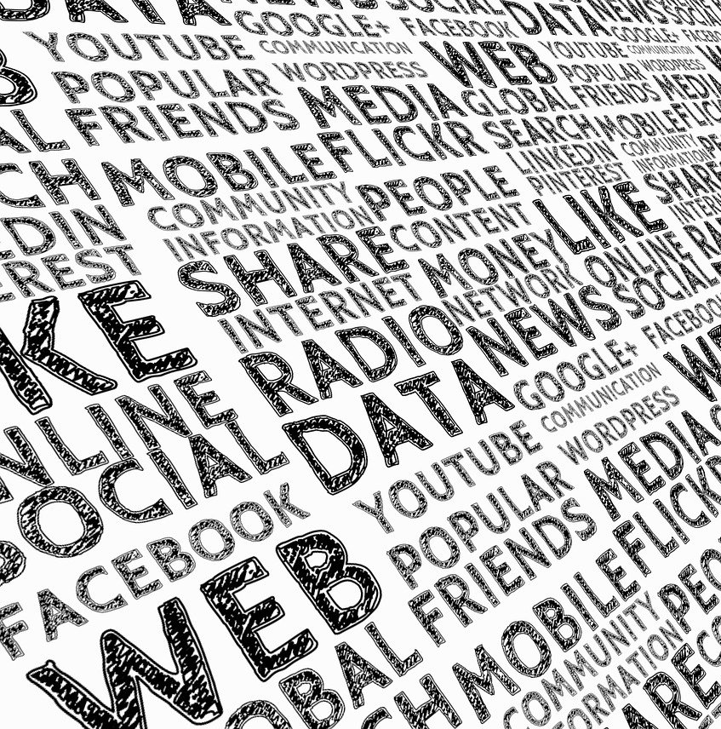


Text Mining: Principles for Automated Qualitative Data Analysis
Dr. Vicenc Fernandez
Edition 2020
Gerd Altmann at Pixabay

Slide 2
Before you get started…
“If you try to boil the ocean, you will never succeed”
- Kaenan Hertz (Ernst & Young) ury
“The simplest algorithms will get better results long term”
- José M Gómez (Pragsis Technologies)

Slide 3


Some Previous Considerations
Qualitative Research
Quantitative Research

Slide 4
Some Previous Considerations
Qualitative Research
Quantitative Research
Mix-Methods Research

Slide 5


Slide 6
Some Previous Considerations
Qualitative
Data
Quantitative
Data
Qualitative Methods
Quantitative Methods

Slide 7

Some Previous Considerations
Qualitative
Data
Quantitative
Data
Qualitative Methods
Quantitative Methods

Slide 8
Some Previous Considerations
Qualitative Research
Qualitative
Data
Quantitative
Data
Qualitative Methods
Quantitative Methods
Quantitative Research

Slide 9
Some Previous Considerations
Qualitative Research
Qualitative
Data
Quantitative
Data
Qualitative Methods
Quantitative Methods
Quantitative Research

Slide 10



Some Previous Considerations
Qualitative Research
Qualitative
Data
Quantitative
Data
Qualitative Methods
Quantitative Methods
Quantitative Research

Slide 11

Agenda
The Three Branches of Text-Mining
Philosophical Approach
Data
Methods: Tools
Methods: Analysis

Slide 12
The Three Branches of Text-Mining

Slide 13

Introduction
Philosophical Approach
Methods
Text Mining
Data

Slide 14

Philosophical Approach

Slide 15
Text Analysis Approaches
Conversation Analysts
How people negotiate the meaning of the conversation.
How people use language pragmatically to define the situations in which they find themselves.
Analyzing Discourse Positions
Typical discursive roles that people adopt in their everyday communication practices.
A way of linking texts to the social spaces in which they have emerged.
Notes:
* Conversation analysts: How to start a conversation with a profesor
* Stories people tell themselves and others in ordinary everyday conversations; a corpus of men’s talk on feminism

Slide 16
Text Analysis Approaches
Critical Discourse Analysis
A qualitative approach to text analysis.
Seeking the presence of features from other discourses in the text or discourse to be analyzed.
Content Analysis
A quantitative approach to text analysis.
Focused on texts themselves.
Notes:
* texts can be analyzed as fragments of discourses that reflect and project ideological domination by powerful groups in society.
* rather than texts’ relations to their social and historical contexts. CODING / CLASSIFICATION

Slide 17
Qualitative Data

Slide 18
Which Qualitative Data Gathered Methods can we use?
Notes:
¿cómo podemos recopilar datos?

Slide 19

Methods of Acquiring Text Data
Traditional
Web Scraping
Web Crawling
Notes:
Web scraping: commercial software and, as needed, programming languages such as Python to identify and download text from one or more pages or archives within a single website.
Web crawling is the process of building a collection of webpages by starting with an initial set of URLs (or links) and recursively traversing the corresponding pages to find additional links.

Slide 20


Traditional Techniques
Interview
Survey with open questions
Set of reports
Observation
Newspapers

Slide 21





Web Scraping
R, Pyhthon, etc.
Notes:
Web scraping: commercial software and, as needed, programming languages such as Python to identify and download text from one or more pages or archives within a single website.
For instance: emails, roles, reports, etc.
For instance: Social Media (Twitter ot Facebook)

Slide 22

Web Crawling
Notes:
Web crawling is the process of building a collection of webpages by starting with an initial set of URLs (or links) and recursively traversing the corresponding pages to find additional links.

Slide 23
Tools

Slide 24



Tools for Text Mining
https://www.r-project.org/
https://python.org/

Slide 25
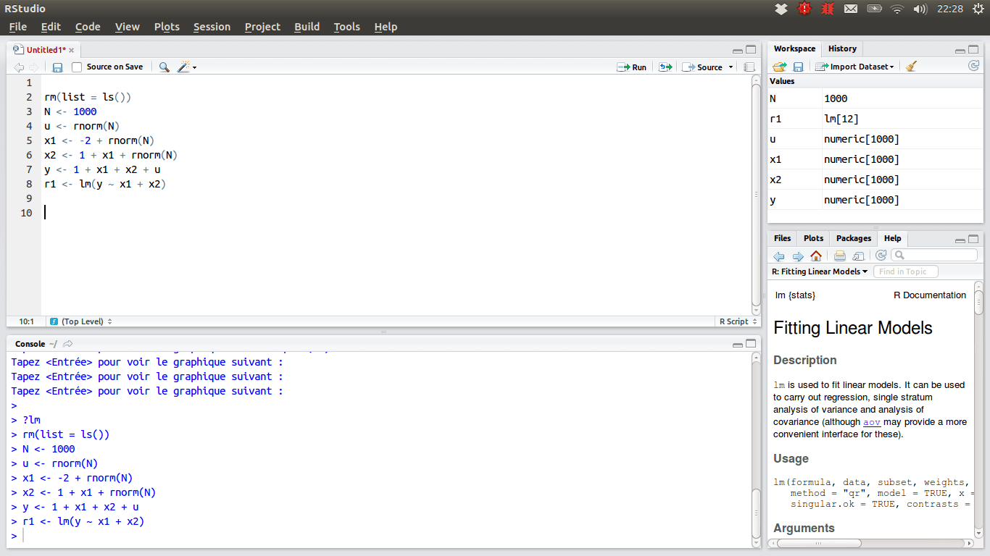
Tools for Text Mining

Slide 26

Tools for Text Mining
LEXIMANCER
https://info.leximancer.com
LINGUISTIC INQUIRY AND WORD COUNT
http://liwc.wpengine.com
RAPIDMINER
http://rapidminer.com
TEXTANALYST
http://megaputer.com/site/textanalyst.php
WORDSTAT
https://provalisresearch.com/products/content-analysis-software

Slide 27
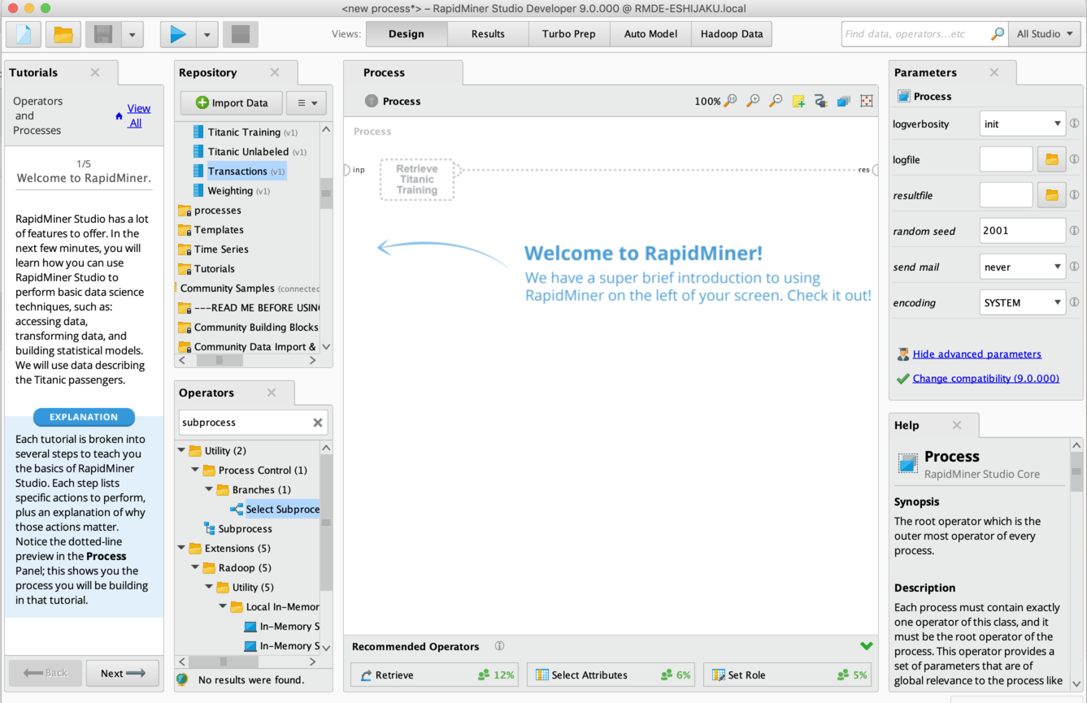
Tools for Text Mining

Slide 28
Notes:
¿cuántos prefieren programa?

Slide 29
Methods

Slide 30
Pre-Process of the Text
The Text in a free format
Transformation (tokenization)
The Text in the tidy text format
Notes:
A token is a meaningful unit of text, most often a word, that we are interested in using for further analysis, and tokenization is the process of splitting text into tokens.

Slide 31

Tidy Data Structure
Each variable is a column
Each observation (token) is a row
Each type of observational unit is a table
Notes:
Token can be: 1 Word, 2 words, a sentence, a parragraph

Slide 32
Tidy Data Structure
Option 1
Option 2
It was the best of times, it was the worst of times, it was the age of wisdom, it was the age of foolishness, it was the epoch of belief, it was the epoch of incredulity, it was the season of Light, it was the season of Darkness, it was the spring of hope, it was the winter of despair, we had everything before us, we had nothing before us, we were all going direct to Heaven, we were all going direct the other way
Token
It was the best of times
it was the worst of times
it was the age of wisdom
it was the age of foolishness
it was the epoch of belief
it was the epoch of incredulity
it was the season of Light
it was the season of Darkness
it was the spring of hope,
it was the winter of despair
we had everything before us
we had nothing before us
…
Token
It
was
the
best
of
times
it
was
the
worst
of
times
…
tokenization
Notes:
Token can be: 1 Word, 2 words, a sentence, a parragraph

Slide 33
Tidy Data Structure
Option 3
It was the best of times, it was the worst of times, it was the age of wisdom, it was the age of foolishness, it was the epoch of belief, it was the epoch of incredulity, it was the season of Light, it was the season of Darkness, it was the spring of hope, it was the winter of despair, we had everything before us, we had nothing before us, we were all going direct to Heaven, we were all going direct the other way
Token | Chapter | Page
It | 1 | 1
was | 1 | 1
the | 1 | 1
best | 1 | 1
of | 1 | 1
times | 1 | 1
it | 1 | 1
was | 1 | 1
the | 1 | 2
worst | 1 | 2
of | 1 | 2
times | 1 | 2
… | … | …
tokenization
Notes:
Token can be: 1 Word, 2 words, a sentence, a parragraph

Slide 34

Question?
Which are the most common words in any language?
Which is the most common word in a novel?

Slide 35

Removing Stop Words
Stop words are words that are not useful for an analysis, typically extremely common words such as “the”, “of”, “to”, and so forth in English.

Slide 36
Removing Stop Words
Option 4
It was the best of times, it was the worst of times, it was the age of wisdom, it was the age of foolishness, it was the epoch of belief, it was the epoch of incredulity, it was the season of Light, it was the season of Darkness, it was the spring of hope, it was the winter of despair, we had everything before us, we had nothing before us, we were all going direct to Heaven, we were all going direct the other way
Token
it
was
best
times
it
was
worst
times
it
was
age
wisdom
…
tokenization
Stops Words
Notes:
Token can be: 1 Word, 2 words, a sentence, a parragraph

Slide 37
Basic Analysis
Text Data
Tokenization
Compare
(correlation)
Tidy Text
Summarized
Text
Plot
Figures / Tables
Summarize
(count-frequency)
Stops Words
Clean Tidy Text

Slide 38
Methods
word and document frequency

Slide 39

Introduction
term frequency (tf), how frequently a word occurs in a document
inverse document frequency (idf), which decreases the weight for commonly used words and increases the weight for words that are not used very much in a collection of documents.
The statistic tf-idf is intended to measure how important a word is to a document in a collection (or corpus) of documents

Slide 40
Example
Document 1
Document 2
Document 3
The water bottle is very common in most houses. If we do a study on how many bottles of water there are in each house, we can discover that the average is three bottles of water in each house.
Water is, together with air, one of the most important elements we can find in the world. There is no house that has water fountains, as well as water inlets and outlets. In Spanish houses there is always hot water.
The main drink in Spain is water. In all the houses it is possible to drink water at any time of the day. In many houses, water is as important as the air they breathe. It is somewhat similar in the rest of the world.
Which is the most important word in these documents?
Notes:
water

Slide 41
Example
Document 1
Document 2
Document 3
The water bottle is very common in most houses. If we do a study on how many bottles of water there are in each house, we can discover that the average is three bottles of water in each house.
Water is, together with air, one of the most important elements we can find in the world. There is no house that has water fountains, as well as water inlets and outlets. In Spanish houses there is always hot water.
The main drink in Spain is water. In all the houses it is possible to drink water at any time of the day. In many houses, water is as important as the air they breathe. It is somewhat similar in the rest of the world.
Which is the most distinctive word in document 1 among all documents?
Notes:
bottle

Slide 42
Example
Document 1
Document 2
Document 3
The water bottle is very common in most houses. If we do a study on how many bottles of water there are in each house, we can discover that the average is three bottles of water in each house.
Water is, together with air, one of the most important elements we can find in the world. There is no house that has water fountains, as well as water inlets and outlets. In Spanish houses there is always hot water.
The main drink in Spain is water. In all the houses it is possible to drink water at any time of the day. In many houses, water is as important as the air they breathe. It is somewhat similar in the rest of the world.
tf (water) = ↑↑
tf (water) = ↑↑
tf (water) = ↑↑

Slide 43
Example
Document 1
Document 2
Document 3
The water bottle is very common in most houses. If we do a study on how many bottles of water there are in each house, we can discover that the average is three bottles of water in each house.
Water is, together with air, one of the most important elements we can find in the world. There is no house that has water fountains, as well as water inlets and outlets. In Spanish houses there is always hot water.
The main drink in Spain is water. In all the houses it is possible to drink water at any time of the day. In many houses, water is as important as the air they breathe. It is somewhat similar in the rest of the world.
tf (water) = ↑↑
tf (water) = ↑↑
tf (water) = ↑↑
df (water) = ↑↑ → idf (water) = ↓↓

Slide 44
Example
Document 1
Document 2
Document 3
The water bottle is very common in most houses. If we do a study on how many bottles of water there are in each house, we can discover that the average is three bottles of water in each house.
Water is, together with air, one of the most important elements we can find in the world. There is no house that has water fountains, as well as water inlets and outlets. In Spanish houses there is always hot water.
The main drink in Spain is water. In all the houses it is possible to drink water at any time of the day. In many houses, water is as important as the air they breathe. It is somewhat similar in the rest of the world.
tf (water) = ↑↑
tf (water) = ↑↑
tf (water) = ↑↑
df (water) = ↑↑ → idf (water) = ↓↓
tf-idf (water) = ↓↓
tf-idf (water) = ↓↓
tf-idf (water) = ↓↓

Slide 45
Example
Document 1
Document 2
Document 3
The water bottle is very common in most houses. If we do a study on how many bottles of water there are in each house, we can discover that the average is three bottles of water in each house.
Water is, together with air, one of the most important elements we can find in the world. There is no house that has water fountains, as well as water inlets and outlets. In Spanish houses there is always hot water.
The main drink in Spain is water. In all the houses it is possible to drink water at any time of the day. In many houses, water is as important as the air they breathe. It is somewhat similar in the rest of the world.
tf (bottle) = ↑↑
tf (bottle) = ↓↓
tf (bottle) = ↓↓

Slide 46
Example
Document 1
Document 2
Document 3
The water bottle is very common in most houses. If we do a study on how many bottles of water there are in each house, we can discover that the average is three bottles of water in each house.
Water is, together with air, one of the most important elements we can find in the world. There is no house that has water fountains, as well as water inlets and outlets. In Spanish houses there is always hot water.
The main drink in Spain is water. In all the houses it is possible to drink water at any time of the day. In many houses, water is as important as the air they breathe. It is somewhat similar in the rest of the world.
tf (bottle) = ↑↑
tf (bottle) = ↓↓
tf (bottle) = ↓↓
df (bottle) = ↓↓ → idf (bottle) = ↑↑

Slide 47
Example
Document 1
Document 2
Document 3
The water bottle is very common in most houses. If we do a study on how many bottles of water there are in each house, we can discover that the average is three bottles of water in each house.
Water is, together with air, one of the most important elements we can find in the world. There is no house that has water fountains, as well as water inlets and outlets. In Spanish houses there is always hot water.
The main drink in Spain is water. In all the houses it is possible to drink water at any time of the day. In many houses, water is as important as the air they breathe. It is somewhat similar in the rest of the world.
tf (bottle) = ↑↑
tf (bottle) = ↓↓
tf (bottle) = ↓↓
df (bottle) = ↓↓ → idf (bottle) = ↑↑
tf-idf (bottle) = ↑↑
tf-idf (bottle) = ↓↓
tf-idf (bottle) = ↓↓

Slide 48
Example
Document 1
Document 2
Document 3
The water bottle is very common in most houses. If we do a study on how many bottles of water there are in each house, we can discover that the average is three bottles of water in each house.
Water is, together with air, one of the most important elements we can find in the world. There is no house that has water fountains, as well as water inlets and outlets. In Spanish houses there is always hot water.
The main drink in Spain is water. In all the houses it is possible to drink water at any time of the day. In many houses, water is as important as the air they breathe. It is somewhat similar in the rest of the world.
tf (car) = ↓↓
tf (car) = ↓↓
tf (car) = ↓↓
Notes:
Puede mirar tf-idf en Wikipedia donde aparece una explciación de su cálculo.

Slide 49
Example
Document 1
Document 2
Document 3
The water bottle is very common in most houses. If we do a study on how many bottles of water there are in each house, we can discover that the average is three bottles of water in each house.
Water is, together with air, one of the most important elements we can find in the world. There is no house that has water fountains, as well as water inlets and outlets. In Spanish houses there is always hot water.
The main drink in Spain is water. In all the houses it is possible to drink water at any time of the day. In many houses, water is as important as the air they breathe. It is somewhat similar in the rest of the world.
tf (car) = ↓↓
tf (car) = ↓↓
tf (car) = ↓↓
df (car) = ↓↓ → idf (car) = ↑↑
Notes:
Puede mirar tf-idf en Wikipedia donde aparece una explciación de su cálculo.

Slide 50
Example
Document 1
Document 2
Document 3
The water bottle is very common in most houses. If we do a study on how many bottles of water there are in each house, we can discover that the average is three bottles of water in each house.
Water is, together with air, one of the most important elements we can find in the world. There is no house that has water fountains, as well as water inlets and outlets. In Spanish houses there is always hot water.
The main drink in Spain is water. In all the houses it is possible to drink water at any time of the day. In many houses, water is as important as the air they breathe. It is somewhat similar in the rest of the world.
tf (car) = ↓↓
tf (car) = ↓↓
tf (car) = ↓↓
df (car) = ↓↓ → idf (car) = ↑↑
tf-idf (car) = ↓↓
tf-idf (car) = ↓↓
tf-idf (car) = ↓↓
Notes:
Puede mirar tf-idf en Wikipedia donde aparece una explciación de su cálculo.

Slide 51
Methods
Sentiment Analysis

Slide 52

Introduction
The use the tools of text mining to approach the emotional content of text programmatically

Slide 53
Basic Analysis
Text Data
Tokenization
Summarize
(count-frequency)
Plot
Tidy Text
Summarized
Text
Figures / Tables
Stops Words
Clean Tidy Text
Sentiment Lexico

Slide 54
Basic Analysis
word
I
am
happy
and
I
get
a
gift
TOTAL
word | value
I | -
am | -
happy | positive
and | -
I | -
get | -
a | -
gift | positive
TOTAL | Positive (+)
Sentiment Lexico

Slide 55
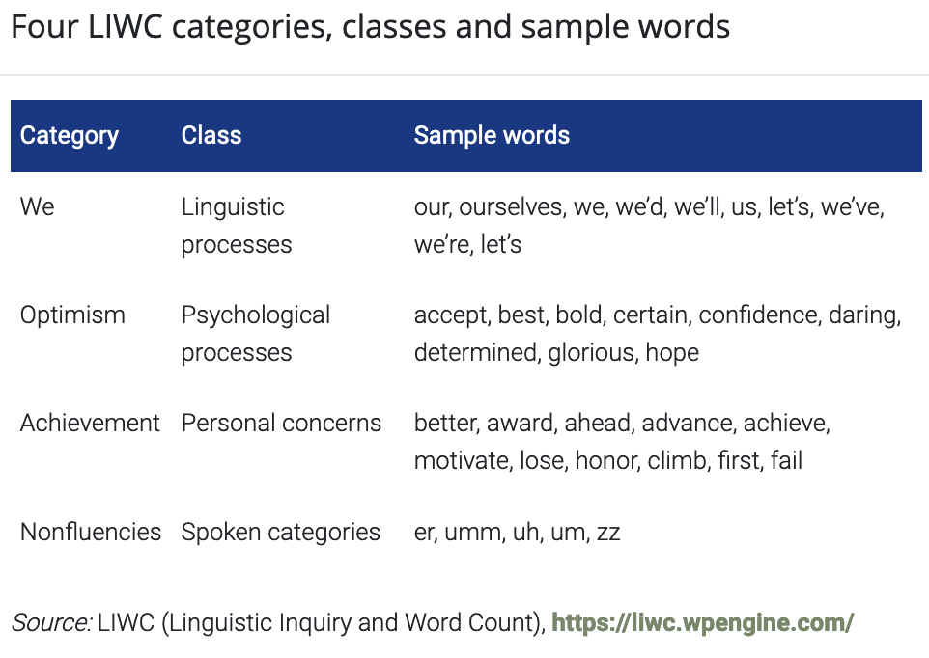

Lexical Resources: Linguistic Inquiry and Word Count
Pennebaker, Francis, and Booth (2001)
Notes:
Linguistic Inquiry and Word Count (LIWC) was developed as a resource for psycholinguistic analysis by Pennebaker, Francis, and Booth (2001)

Slide 56
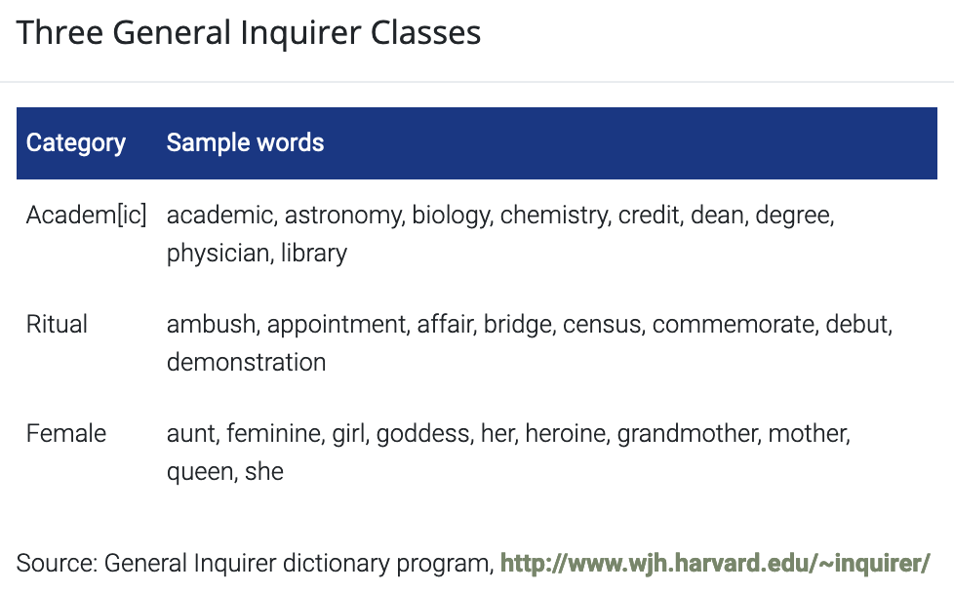
Lexical Resources: General Inquirer
Stone & Hunt (1963)
Notes:
The General Inquirer (Stone & Hunt, 1963) is a dictionary of about 10,000 words grouped into about 100 categories.
* positive and negative sentiment categories.

Slide 57
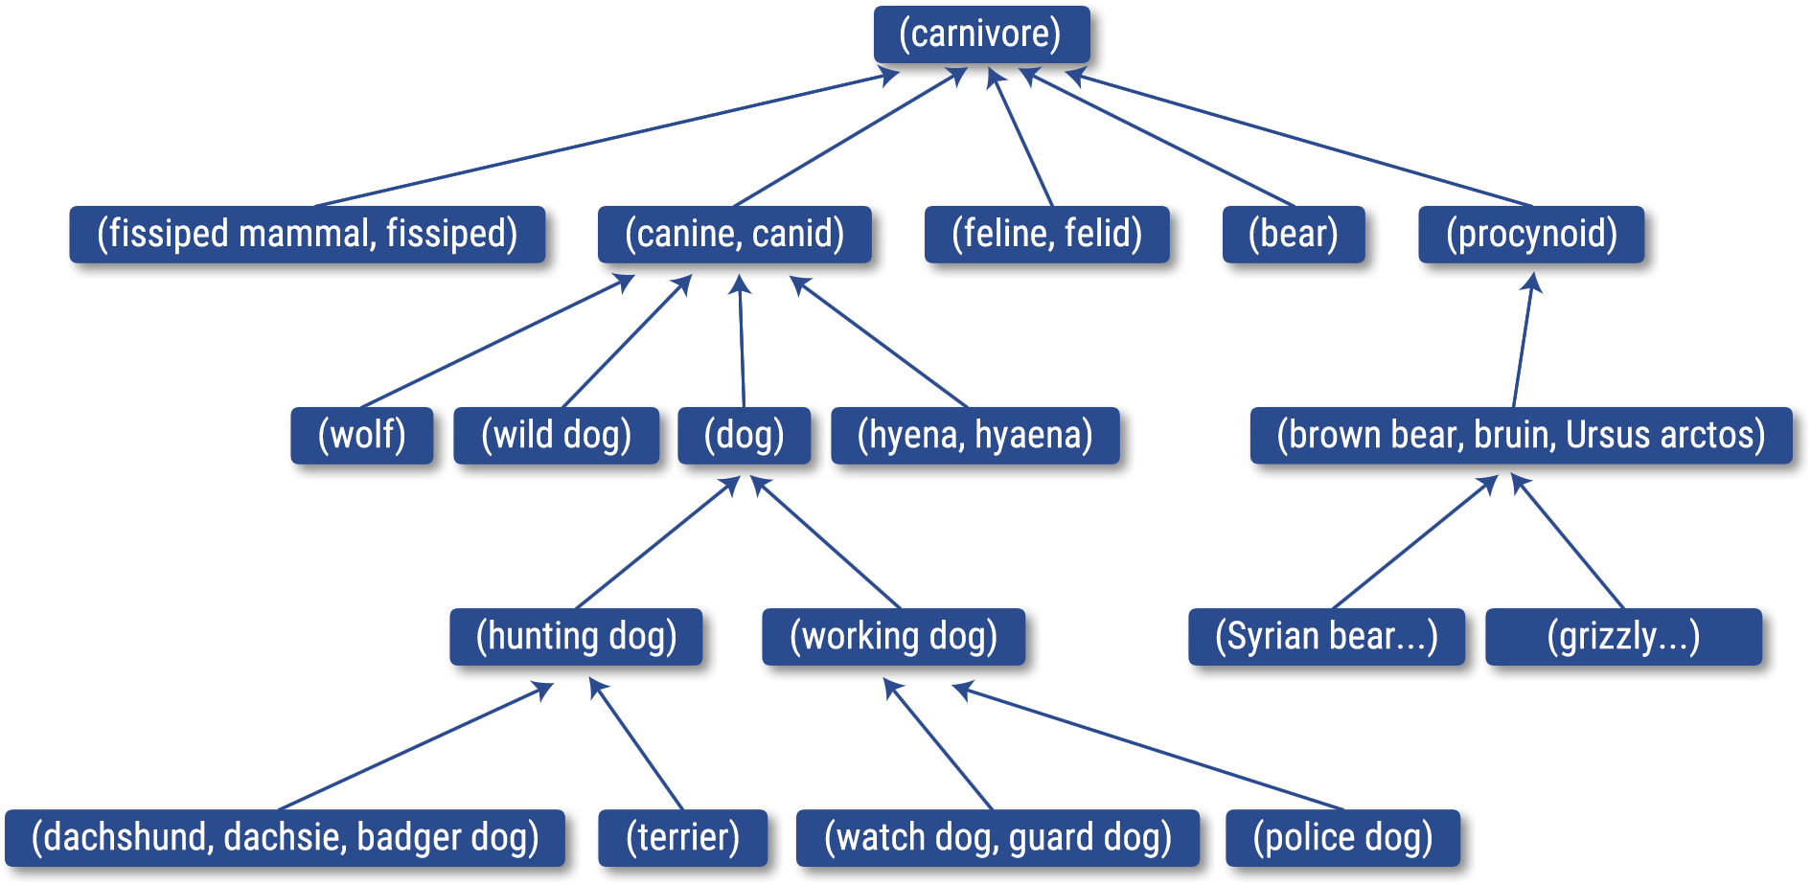
Lexical Resources: Wordnet
Notes:
* WordNet covers the majority of nouns, verbs, adjectives, and adverbs in the English language, along with a rich set of semantic relations that connect these concepts.
* Words in WordNet are organized in synonym sets, also called synsets.

Slide 58
Lexical Resources: The three most commons
AFINN by Finn Årup Nielsen
yes/no: positive, negative, anger, anticipation, disgust, fear, joy, sadness, surprise, and trust
bing by Bing Liu and collaborators
yes/no: positive, negative
nrc by Saif Mohammad and Peter Turney
between -5 and 5: negative - positive
Notes:
The nrc lexicon categorizes words in a binary fashion (“yes”/“no”) into categories of positive, negative, anger, anticipation, disgust, fear, joy, sadness, surprise, and trust.
The bing lexicon categorizes words in a binary fashion into positive and negative categories.
The AFINN lexicon assigns words with a score that runs between -5 and 5, with negative scores indicating negative sentiment and positive scores indicating positive sentiment.

Slide 59
Lexical Resources: The three most commons
AFINN by Finn Årup Nielsen
word | value
abacus | trust
abandon | fear
abandon | negative
abandon | sadness
abandoned | anger
abandoned | fear
abandoned | negative
abandoned | sadness
abandonment | anger
abandonment | fear

Slide 60
Lexical Resources: The three most commons
bing by Bing Liu and collaborators
word | value
2-faces | negative
abnormal | negative
abolish | negative
abomidable | negative
anominably | negative
abominate | negative
abomination | negative
abort | negative
aborted | negative
aborts | negative

Slide 61
Lexical Resources: The three most commons
nrc by Saif Mohammad and Peter Turney
word | value
abandon | -2
abandoned | -2
abandons | -2
abducted | -2
abduction | -2
abductions | -2
abhor | -3
abhorred | -3
abhorrent | -3
abhors | -3

Slide 62
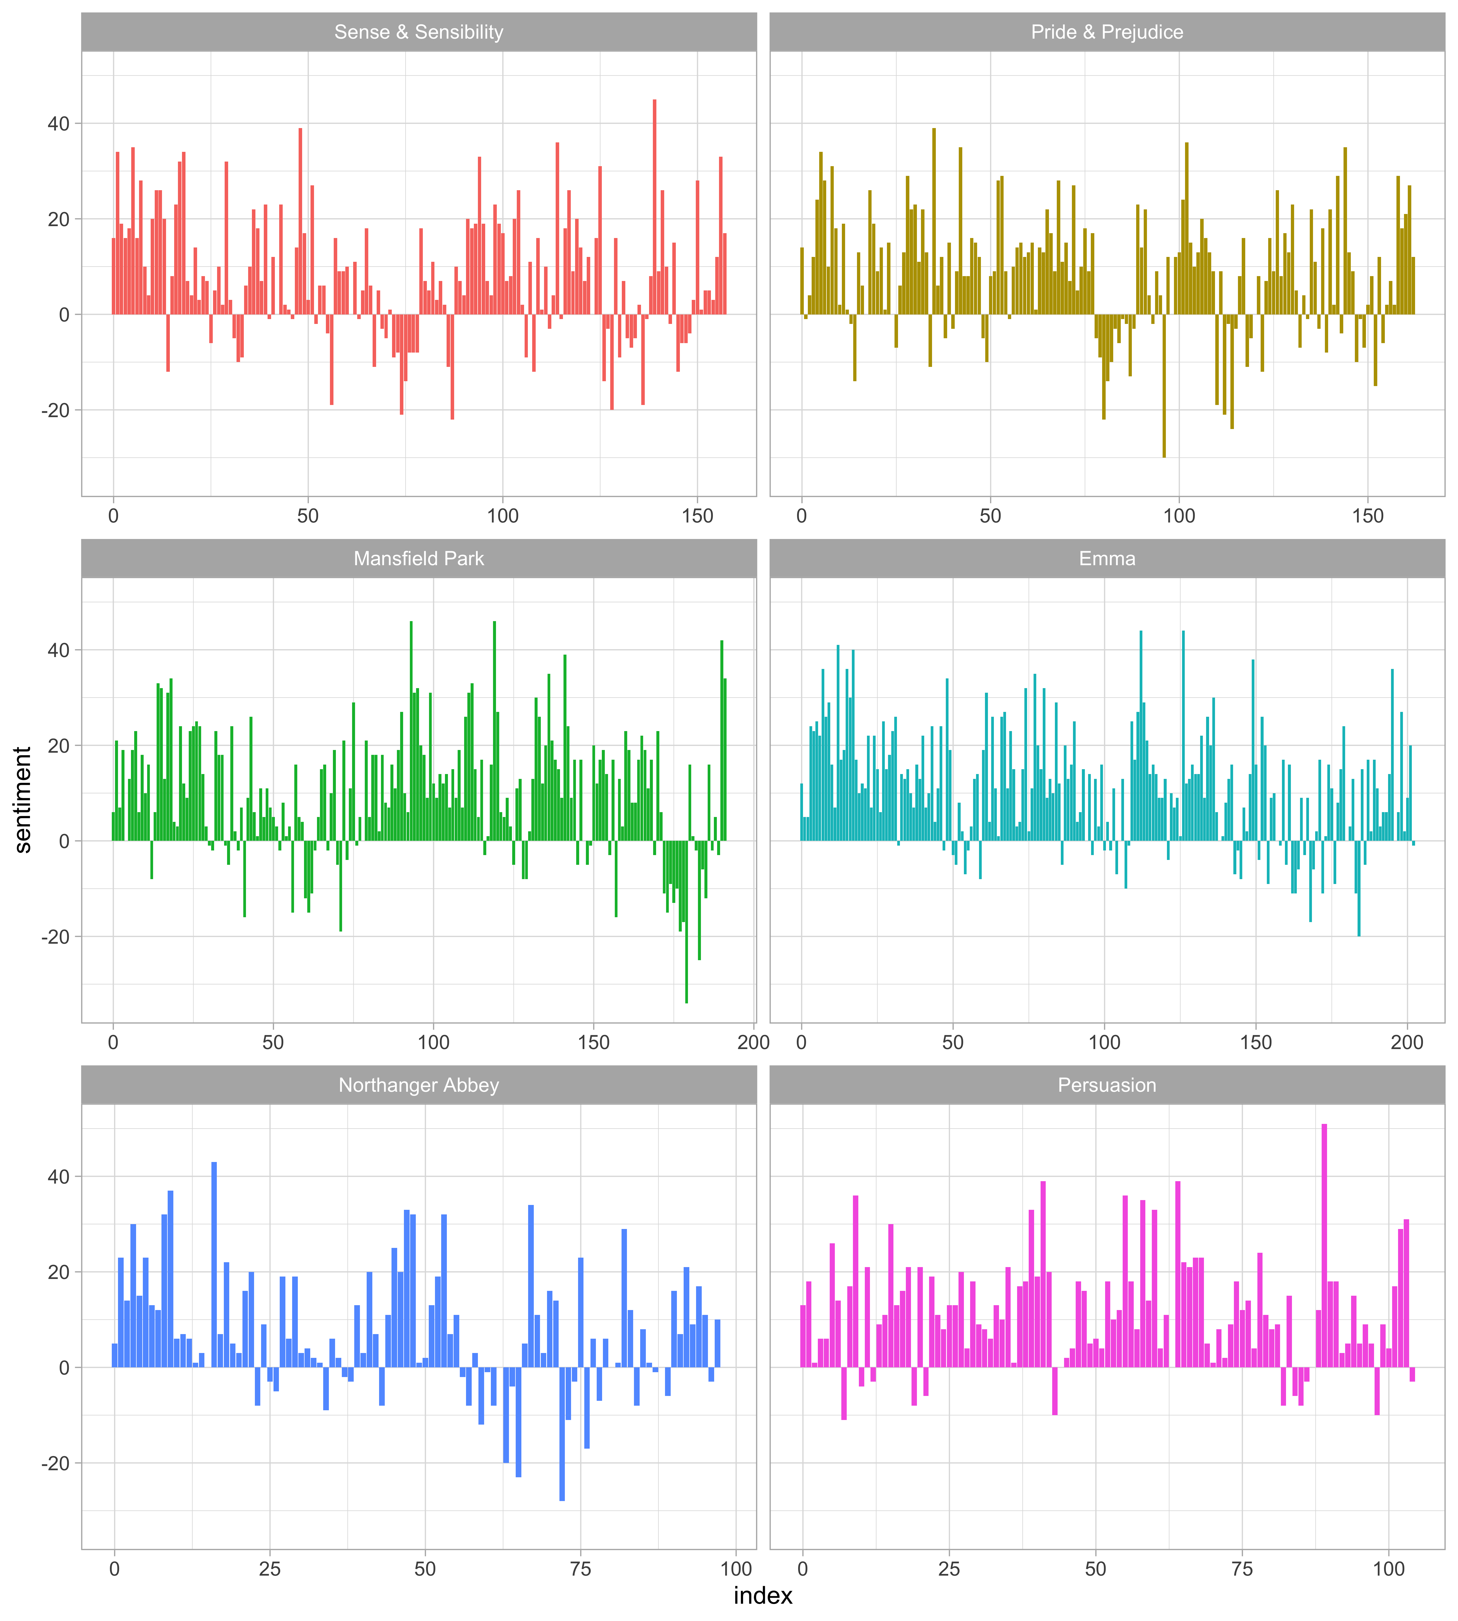

Example

Slide 63
Example

Slide 64
Example

Slide 65
Example

Slide 66
Methods
Relationships between Words

Slide 67


Tokenizing by n-gram
We can analyze tokens with two, three or more words, which we call n-grams
Pairs of consecutive words might capture structure that isn’t present when one is just counting single words, and may provide context that makes tokens more understandable
Notes:
Name of cities or streets

Slide 68

Example: Bi-gram
Bi-grams
Option B
(stop words)
Option A
It was the best of times, it was the worst of times, it was the age of wisdom, it was the age of foolishness, it was the epoch of belief, it was the epoch of incredulity, it was the season of Light, it was the season of Darkness, it was the spring of hope, it was the winter of despair, we had everything before us, we had nothing before us, we were all going direct to Heaven, we were all going direct the other way
Token
It was
was the
the best
best of
of times
times it
it was
was the
the worst
worst of
of times
times it
…
Token
it was
was best
best times
times it
it was
was worst
worst times
times it
it was
was age
age wisdom
wisdom it
…
tokenization
Notes:
Token can be: 1 Word, 2 words, a sentence, a parragraph

Slide 69
Example: Tri-gram
Tri-grams
Option B
(stop words)
Option A
It was the best of times, it was the worst of times, it was the age of wisdom, it was the age of foolishness, it was the epoch of belief, it was the epoch of incredulity, it was the season of Light, it was the season of Darkness, it was the spring of hope, it was the winter of despair, we had everything before us, we had nothing before us, we were all going direct to Heaven, we were all going direct the other way
Token
It was the
was the best
the best of
best of times
of times it
times it was
it was the
was the worst
the worst of
worst of times
of time it
times it was
…
Token
it was best
was best times
best times it
times it was
it was worst
was worst times
worst times it
times it was
it was age
was age wisdom
age wisdom it
wisdom it was
…
tokenization
Notes:
Token can be: 1 Word, 2 words, a sentence, a parragraph

Slide 70

Sentiment Analysis with n-grams
We can improve the results using 2-grams, and 3-grams, because we are giving context to the words

Slide 71
Example
I am not happy and I don’t like it!

Slide 72
Example
I am not happy and I don’t like it!
Word | Feeling
I
am
not
happy
and
I
don’t
like
it

Slide 73
Example
I am not happy and I don’t like it!
Word | Feeling
I | -
am | -
not | Negative (-1)
happy | Positive (+1)
and | -
I | -
don’t | Negative (-1)
like | Positive (+1)
it | -
 | Neutral (0)

Slide 74
Example
I am not happy and I don’t like it!
Word | Feeling
I | -
am | -
not | Negative (-1)
happy | Positive (+1)
and | -
I | -
don’t | Negative (-1)
like | Positive (+1)
it | -
 | Neutral (0)
Word | Feeling
I am
am not
not happy
happy and
and I
I don’t
don’t like
like it

Slide 75
Example
I am not happy and I don’t like it!
Word | Feeling
I | -
am | -
not | Negative (-1)
happy | Positive (+1)
and | -
I | -
don’t | Negative (-1)
like | Positive (+1)
it | -
 | Neutral (0)
Word | Feeling
I am | -
am not | Negative (-1)
not happy | Negative (-1)
happy and | Positive (+1)
and I | -
I don’t | Negative (-1)
don’t like | Negative (-1)
like it | Positive (+1)
 | Negative (-2)

Slide 76

Networks
The visualization all of the relationships among words into a network, or “graph.” where there are three variables:
from: the node an edge is coming from
to: the node an edge is going towards
weight: A numeric value associated with each edge

Slide 77

Pairwise correlation
We may instead want to examine correlation among words, which indicates how often they appear together relative to how often they appear separately.
phi coefficient - measure of association for two binary variables

Slide 78
References
Robinson, David. 2016. gutenbergr: Download and Process Public Domain Works from Project Gutenberg. https://cran.rstudio.com/package=gutenbergr.
Robinson, David. 2017. broom: Convert Statistical Analysis Objects into Tidy Data Frames. https://CRAN.R-project.org/package=broom
Silge, Julia. 2016. janeaustenr: Jane Austen’s Complete Novels. https://CRAN.R-project.org/package=janeaustenr.
Silge, Julia, and David Robinson. 2016. “tidytext: Text Mining and Analysis Using Tidy Data Principles in R.” JOSS 1 (3). https://doi.org/10.21105/joss.00037.

Slide 79
vicenc.fernandez@upc.edu

